Slide 1
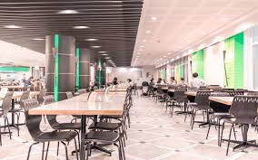
Mess Management System
Project Presentation
ON
Presented By
Miss. SRUSHTI ARUN KOKARE
DEPARTMENT OF TECHNOLOGY,KOLHAOUR

Slide 2
CONTENT
Introduction
Choice of topic with Reasoning
Objective
Literature Survey
Proposed System Architecture
Module’s
System Design
Implementation Details
Hardware & software Requirement
Form Design
Result
Reference

Slide 3
Introduction
Mess Management System is one kind of Human Resource Management System . It will hold everything of any Hostel/Mess Management Count Down.
In many organizations, entire mess management and billing calculations are done manually till date. It is very time consuming and increases the chances of performing calculation mistakes. It would be possible to do the same work within a short period of time and without using much efforts and manpower if there existed an application for the same.
The application is not only restricted to food items and their billing manipulations, but handling the information of the Student is also possible in the software.
The admin software will allow the mess administrator to make changes to the daily mess menu, upload food consumption statistics and view net profit, view orders for the night mess and approve any special lunch orders as well along with reading feedback.

Slide 4
The student software allows students to login and choose the monthly mess option, place orders for the night canteen online, book the mess for special occasions, view the daily mess menu and the night canteen (NC) menu, view food consumption statistics, inform the mess authorities when he/she won't be eating in the mess and submit feedback.
we have proposed an attendance monitoring system based on the concept RFID card and also a Wi-Fi which is implemented as an online mobile application for if RFID card is not working for a while, that communicates with the database residing on a remote server.
Also, The purpose for developing this software is to generate the report automatically at the end of the session or in the between of the session, weekly , monthly, yearly etc.
such a software that is easy to use will reduce the work of mess managers who still maintain all the logs in registers and files. It would be of great benefit as all calculations would be done easily on the click of a button.

Slide 5
Choice of topic with Reasoning
The Challenges encountered by the manual system in mess is efficiency and customer satisfaction. The experience of ordering in most fast food mess is not pleasant for customers. Customers have to make long queues before placing the order and when the order is placed they have to wait near the counter until the order is prepared. The another problem is efficiency that food mess should maintain in their standard operations and keep with the quality of their product and services no matter how much crowd is present in mess but they have to maintain efficiency as well as quality of product .however, we think that there are some issue concerning the traditional way to order food in mess.
The reason to select this topic for project is, to solve the problems occurring during the maintain the records of attendance of student in mess. To maintain the attendance manually using the pen and paper is very time consuming and hard to maintain. Also it need to maintain all transactional details, so if we use application for it instead of maintain it manually keep us in tract about the student attendance and their transactional details. The main feature of it is, we can maintain the records of student attendance and their transactional details per student. So make transaction easily at any time. it is also sharable to head of department .also it has parental control of mess manager and head of department.
To make easy this process of maintaining records of students attendance and transaction in mess, we have choose this topic.

Slide 6
Objectives
The Mess Management System helps the user to access all the functionalities of the mess without having to visit the mess physically and to apply for leave.
It enables the admin to view the inventory and access guest details. This application is free of cost for the users.
Individuals who wish to use any functionality of the mess can simply log in to the app and have everything on their fingertips.
It uses the internet to update all user queries and put it across to the admin.
Using the information provided by all the users the admin can take decisions and the inventory for the mess can be managed.

Slide 7
Literature Survey
The overall goal of this project was to firstly study and understand the existing mess/canteen management applications, then identify the limitations and contribute in the same topic with greater benefits. The main advantage of our proposed system over other existing systems is the GUI in Marathi language. This has enabled complete understanding and convenience for the user. Also, complex calculations are done within seconds and bills are generated on the single click of a button. As the name suggests, it is a software for maintaining any mess/canteen but it also enables handling of the information related to the students/employees who are a part of the organization. Another attractive feature in our software which is lacking in the existing applications is the Backup and Recovery option. All data can be stored as a copy, that is, taking backup is also possible on a single click, plus recovery of lost data in case any failure occurs is also possible on a single click.
Thus, this system with great added features will serve beneficial to the people. Mess Management System will help small business owner to manage their business. This project is developed for Hostel Mess Management System. Much such software is available in market but they are tedious and complicated with complicated user interface. But Mess Management System is web based application so we can provide very user friendly UI which is easy to understand and manage.

Slide 8
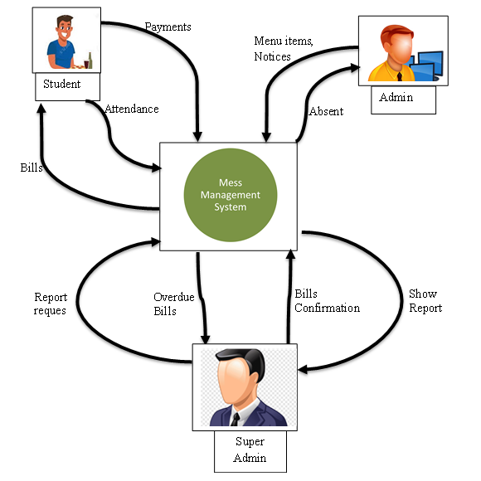
Proposed System Architecture

Slide 9
Proposed System Architecture
There are three major blocks in our application, an android application, a web application, a database and a web services API that interacts with all three parts and carries out all the transactions. Architectural diagram is shown figure.
The android application will be accessible to the user from the client side.
The user interacts with APIs to send and query for information within the system.
The client side will be designed in XML and functionality will be provided through java. The web service will be provided by Apache.

Slide 10
Modules
Student Module:
Login – The student logs into the system so that he can carry on with other options like choosing mess option or placing orders for the night canteen. The student has to enter his ID number and password which will be then compared with the database entries to validate his login credentials.
Change Password – The student changes the current account password. To do this he has to retype old password so that his identity can be confirmed by matching it with database entires and after it has been validated, he has to enter a new password, which will then be updated in the database.
Choose Mess Option – The student chooses his monthly mess option, A or C mess. His choice is then sent to the database where it is updated. This option is only available for fixed dates in a month and cannot be changed on any other days. If no option is chosen, one will be randomly selected.

Slide 11
Modules
View Menu – The student gets to view the menu for the week. He can also choose to view a particular menu like Monday's lunch menu or the Night mess menu. The query from the student is sent to the database where the data is read and is sent back to the student to be displayed on the screen.
View Statistics – The student's query for Statistics is sent to the database on the server where the relevant data is read and sent back to the student. The statistics include the food consumption and can be viewed in a daily, weekly or monthly format and shows what percent of people ate and how much food was consumed and wasted.
Book NC order – The student can view the night mess menu and choose items from it to preorder online. This saves a lot of time and is more efficient than standing in a queue. The student's order is sent to the database where it is processed by the system. The student can also view the current order status and collect it when it is ready.

Slide 12
Modules
Book Special Order – This option is meant for clubs and departments or any group of students who want to book the mess for a particular time and date and have a special lunch or dinner. It involves submitting the requirements of the order to the mess admin who has to approve it and provide a quotation for the amount. The system has to validate the order by checking if the mess hasn't already been booked for that time.
Swipe Card / Enter ID – When the student goes to the mess, he has to either swipe the card or enter his ID. The Id entered will be looked up in the database to check if the student has registered for that mess and if he has already eaten or not. This will be reset after each meal. A failure or success message will be displayed based on the validation result.
Logout – The student logs out of the system so that nobody else can modify his mess option or book orders from his account.

Slide 13
Modules
Admin Module:
Login – The administrator has to login to the system so that he can carry on with the other activities such as updating the mess menu, approving special orders, viewing and uploading statistics, viewing NC orders etc. The data entered will be matched with the fields in the database to validate the admin's credentials.
Change Password – The admin changes the current account password. To do this he has to retype old password so that his identity can be confirmed by matching it with database entries and after it has been validated, he has to enter a new password, which will then be updated in the database.
Update Menu – The administrator can update the menu for any meal for any day of the week or the might mess menu by selecting new food items to add to the menu or by removing unpopular food items. The changes after the updation are saved in the database so that the students can see the updated menu.

Slide 14
Modules
View NC Orders – The admin can check the number of orders received for the night mess and also pass along that to the kitchen staff so that they can prepare the meals according to those specifications. The admin can then update the order status in the database to completed so that the student can come and pick it up after which its status will be delivered.
Approve Special Orders – The admin can view the Special orders submitted by a group of students, provide a quotation for the special meal and if that is acceptable to the group, he can approve the order so that on that day, food for the special order will be prepared for that group of students. These changes will be updated in the database so that the student can view the order status and total cost.
View Feedback – The mess admin can view the feedback submitted by the students. The database will be queried for feedback and complaints and the admin can check all these forms and take the required action on them. He can also update the feedback status as read or the complaint status as per its current state.

Slide 15
Modules
Reset System – The mess admin can trigger a hard reset of the system where the list of people who have eaten their meal is erased. This will typically occur automatically after every meal and so this hard reset will seldom be used.
Logout – The mess admin can log out safely while he/she is not using the software in order to avoid any misuse.

Slide 16
System Design : ER Diagram
email
PRN
uname
address
password
M_id
contact
name
U_id
Student
get
Menu
qty
type
Make
get
B_id
A_id
U_id
date
Manage
U_id
Bill
amount
Attendance
date
generates
status
collect
utype
notify
Admin
U_id
SAdmin
uname
U_id
password
utype
generates
Reports
uname
password
R_id
R_name

Slide 17
System Design : Use case(student)
Account create
Account Login
Mark Attendance
View Menu List
Change Password
Student
View Bill payment
Feedback
Account Logout

Slide 18
System Design : Use case(admin)
Account create
Account Login
Account Login
Attendance Notify
Manage Menu List
Admin
Active student list
Bill payment notify
Feedback Notify
Account Logout

Slide 19
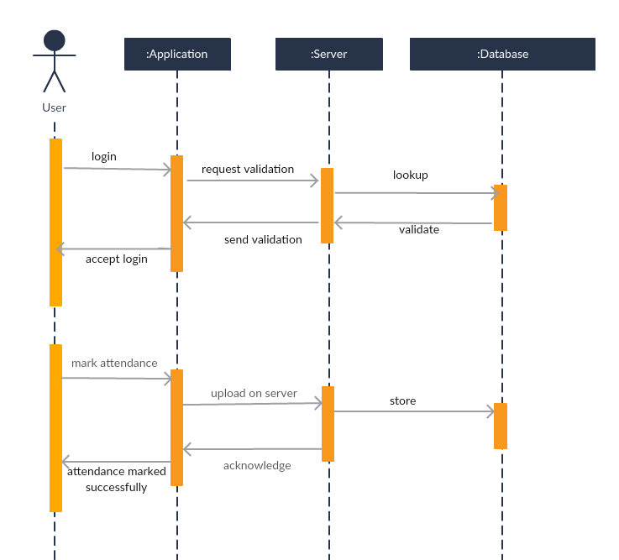
System Design : Sequence Diagram

Slide 20
System Design : Sequence Diagram

Slide 21
System Design : Sequence Diagram

Slide 22
System Design : Sequence Diagram

Slide 23
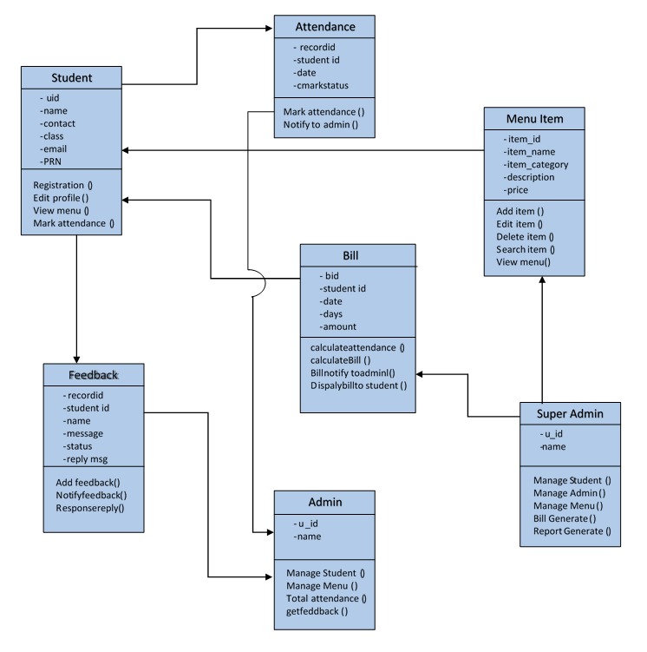
System Design : Class Diagram

Slide 24
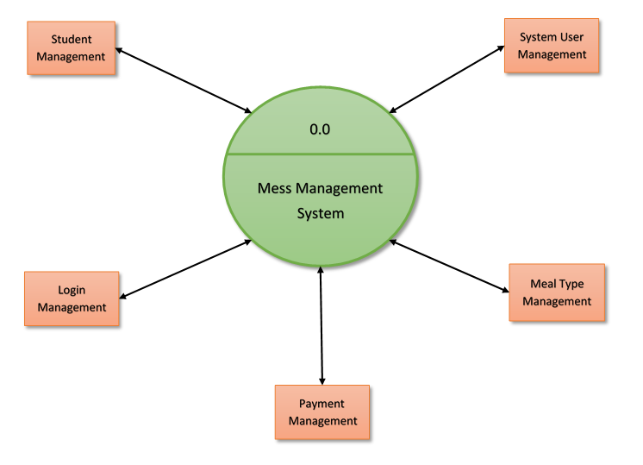
System Design : Zero level DFD

Slide 25
Implementation Details
The physical machine to be used in the mess needs to have internet access in order to connect to the database. This software will not assume that a code scanner hardware is available on the machine, and so the ID input will be done via keyboard. Students need internet access on their devices as well, since all the data will be stored on the database which the software will need to connect to.
Application implements using software development life cycle:
Software Development Life Cycle (SDLC) is a process used to conceptualize, design and develop high-quality software solutions that meet customer expectations and are delivered within predefined time and cost estimates.
SDLC is important because it breaks down the entire life cycle of software development thus making it easier to evaluate each part and guarantee its successful execution.
The Software Development Life Cycle has 7 phases that govern each step of the software development process from planning to development, to testing and from deployment to maintenance.

Slide 26
Hardware & Software Requirement
Server System (Minimum Configuration) :
Processor: Pentium 3
RAM: Minimum 512 MB or above
Hard
Disk: 40GB
Client side
Processor: Dual Core
RAM: Minimum 512 MB
Hard Disk: at least 40 GB
Software Specification:
Platform: Window XP, Window 7, Window 8
Front End: HTML, CSS, JavaScript, android
Back End: PHP, MySQL
Browser: Internet explorer 8.0 and above, Mozilla Firefox, Google Chrome etc.

Slide 27
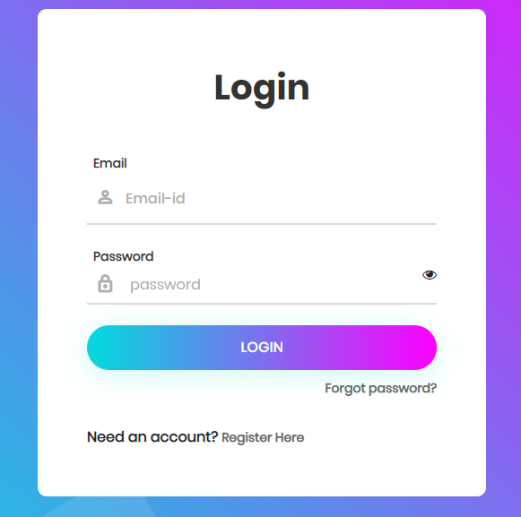
Form Designing(Login)

Slide 28
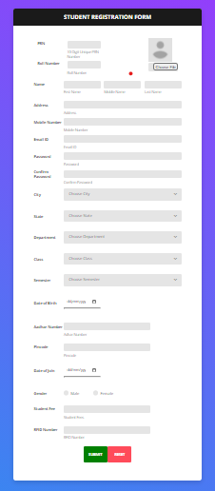
Form Designing( Student Registration)

Slide 29
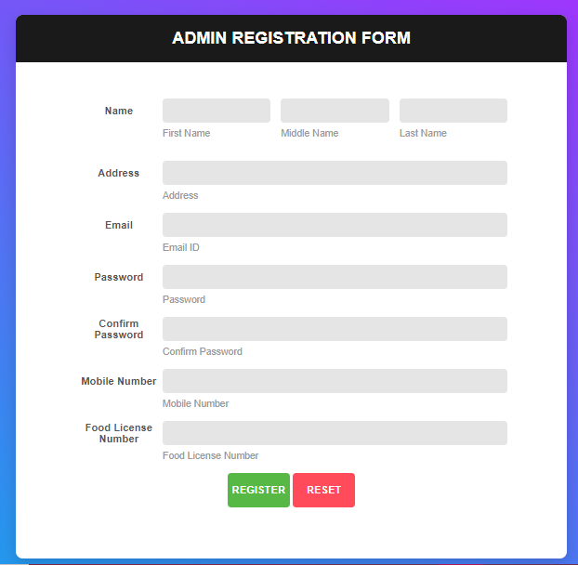
Form Designing( Admin Registration)

Slide 30
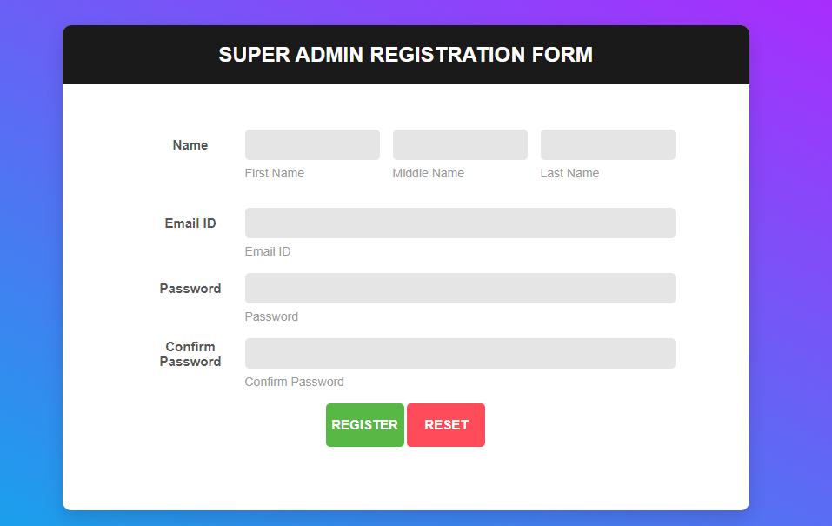
Form Designing( Super Admin Registration)

Slide 31
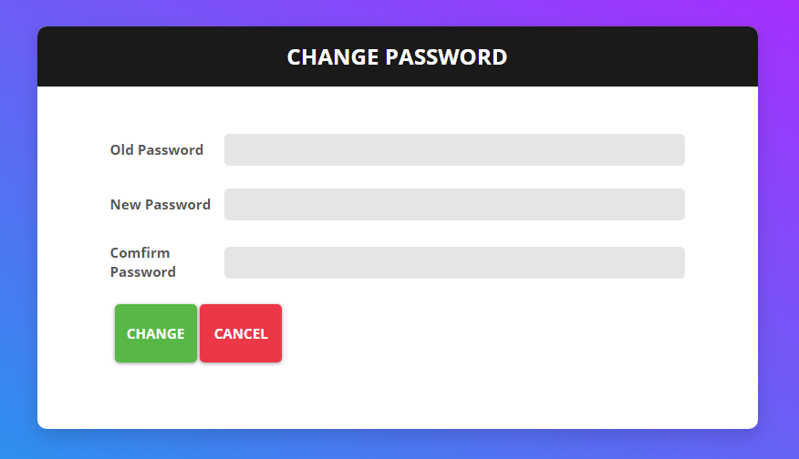
Form Designing(Reset Password)

Slide 32
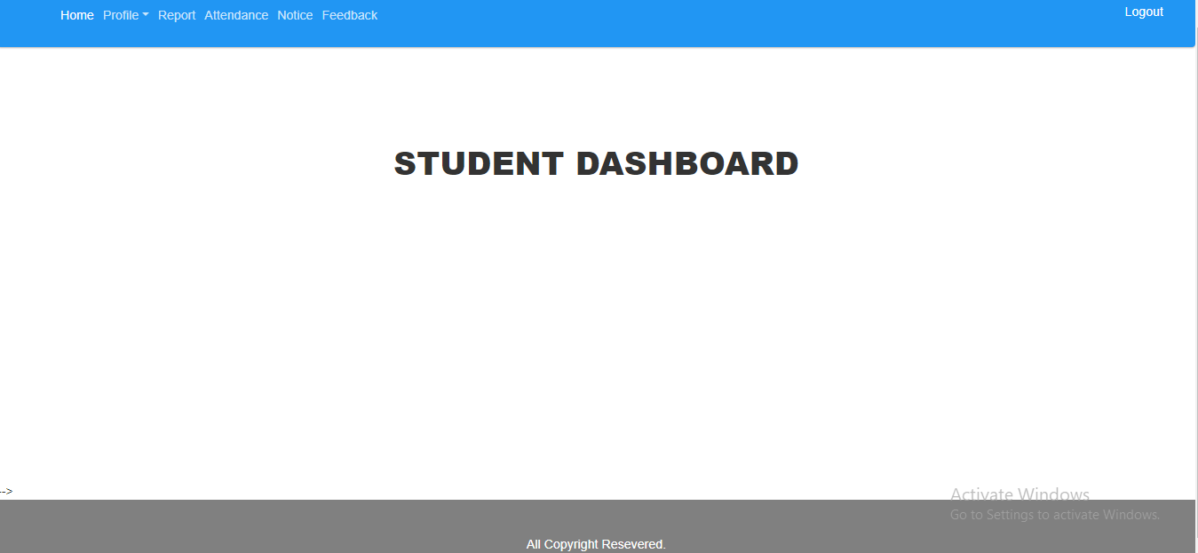
Form Designing(Student Dashboard)

Slide 33
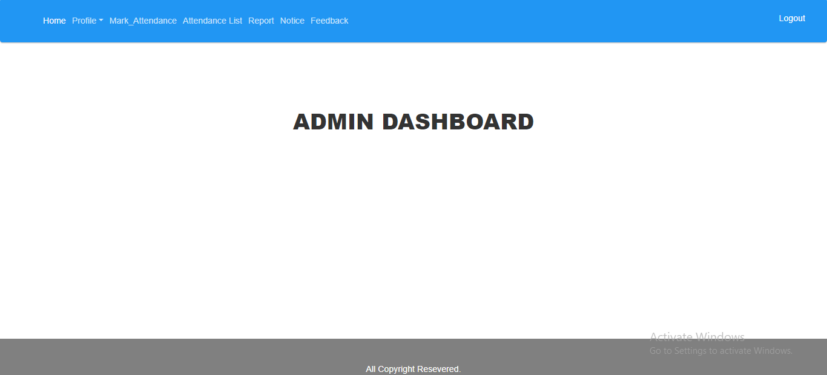
Form Designing(Admin Dashboard)

Slide 34
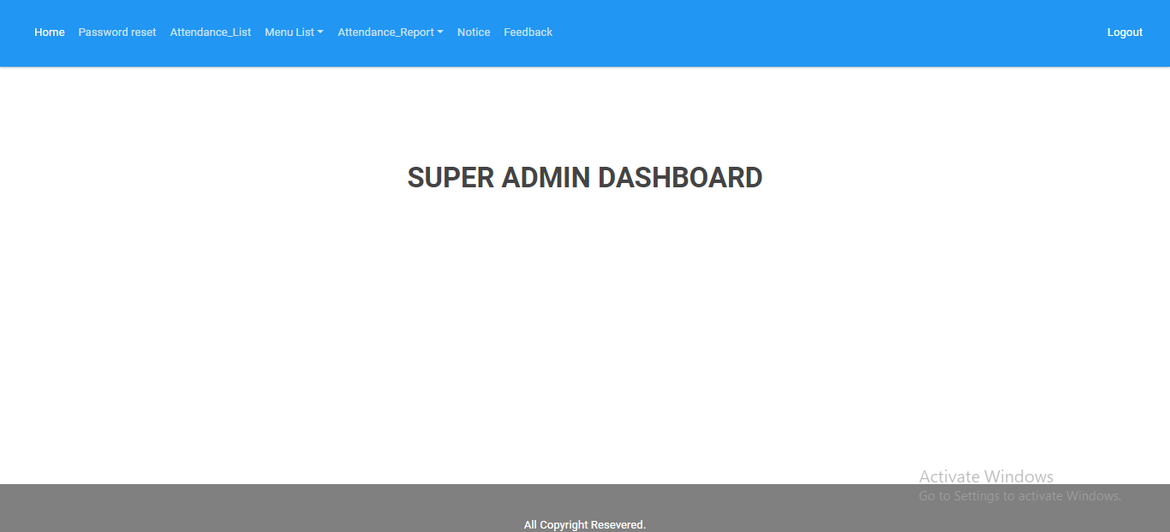
Form Designing(super Admin Dashboard)

Slide 35
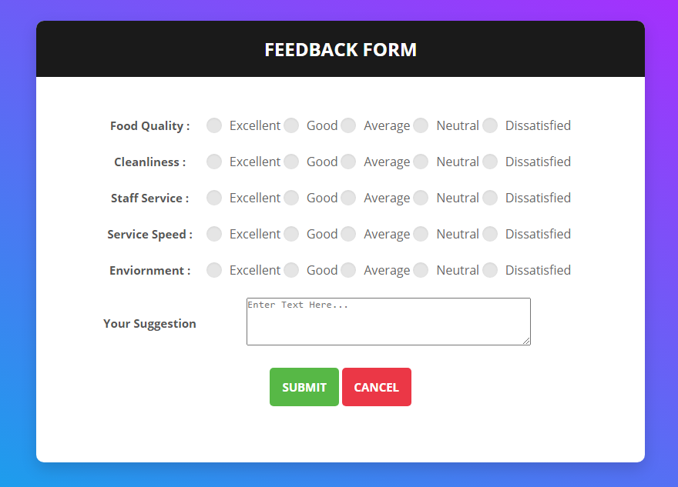
Form Designing(Student Feedback)

Slide 36
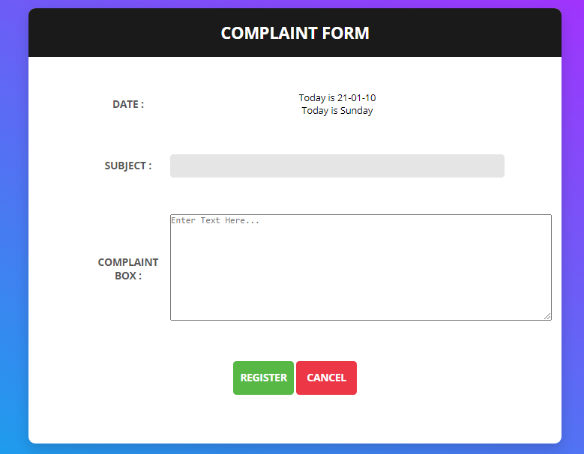
Form Designing(Complaint Box)

Slide 37
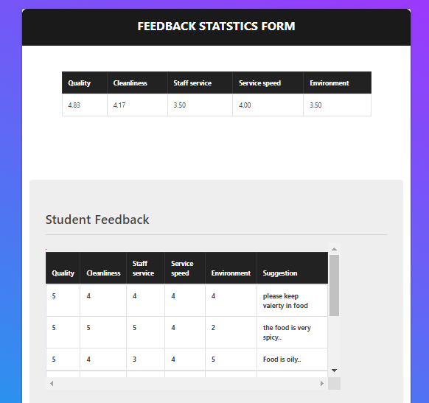
Form Designing(Feedback Statistics )

Slide 38
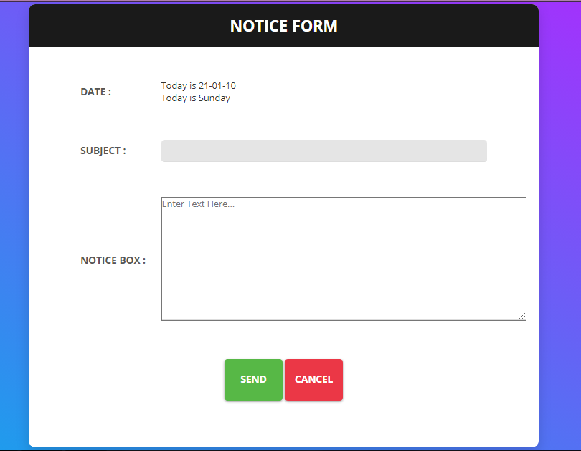
Form Designing(Notice Box)

Slide 39
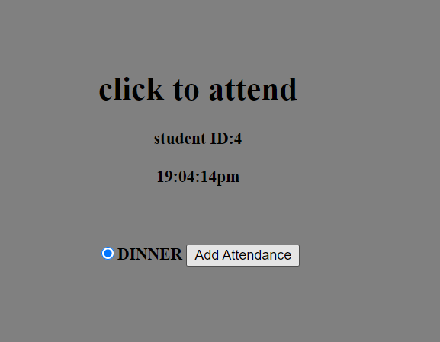
Form Designing(Student Attendance for meal)

Slide 40
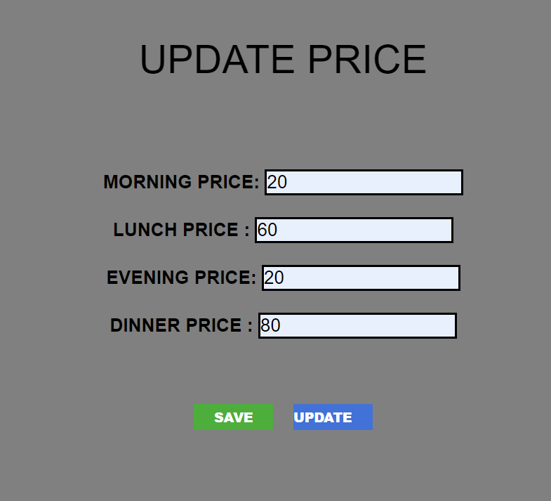
Form Designing(Menu Pricing)

Slide 41
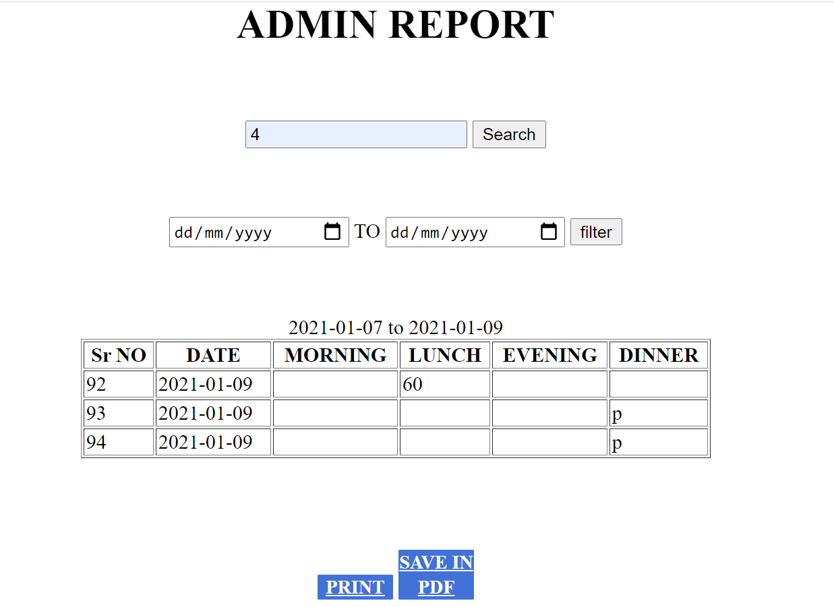
Form Designing (Student wise attendance Report)

Slide 42
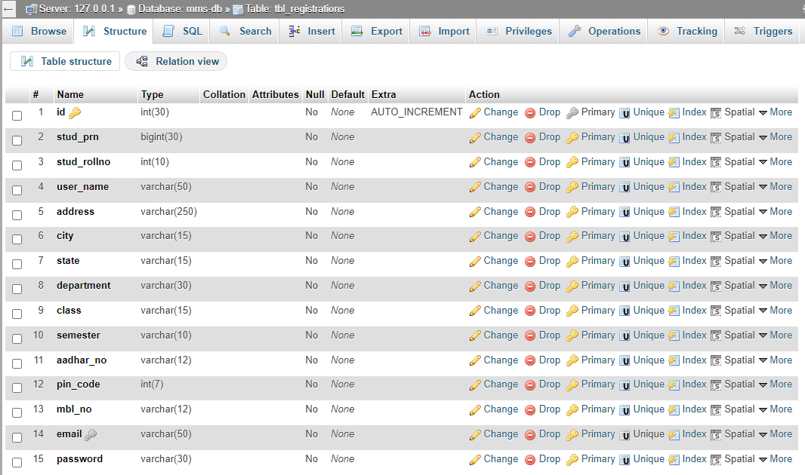
Student Registration Database

Slide 43
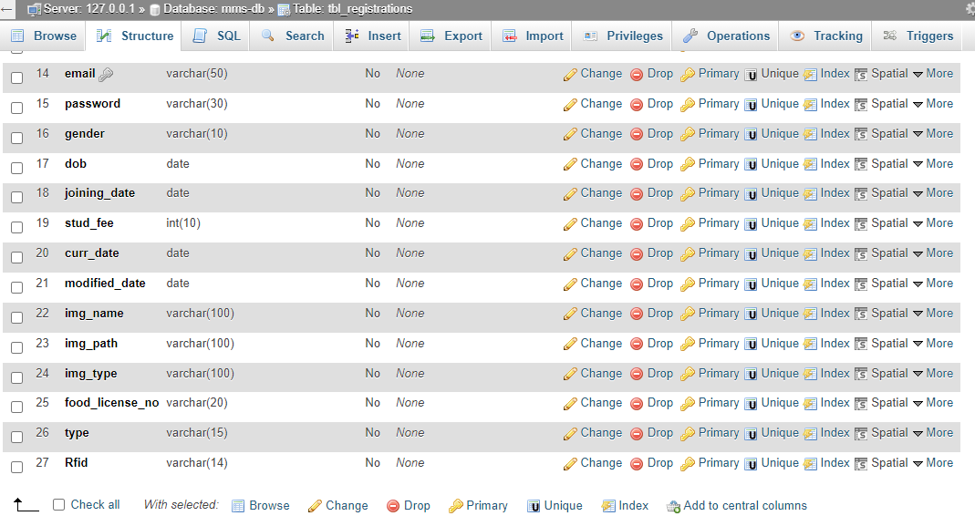

Slide 44
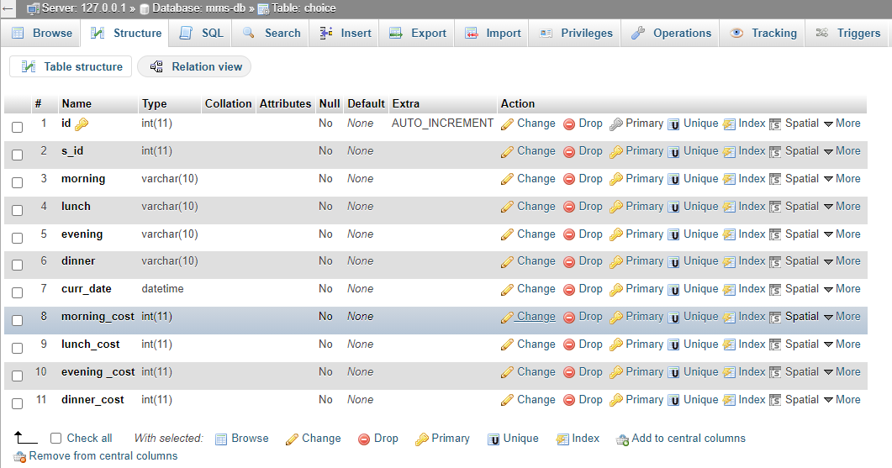
Mess Time Database

Slide 45
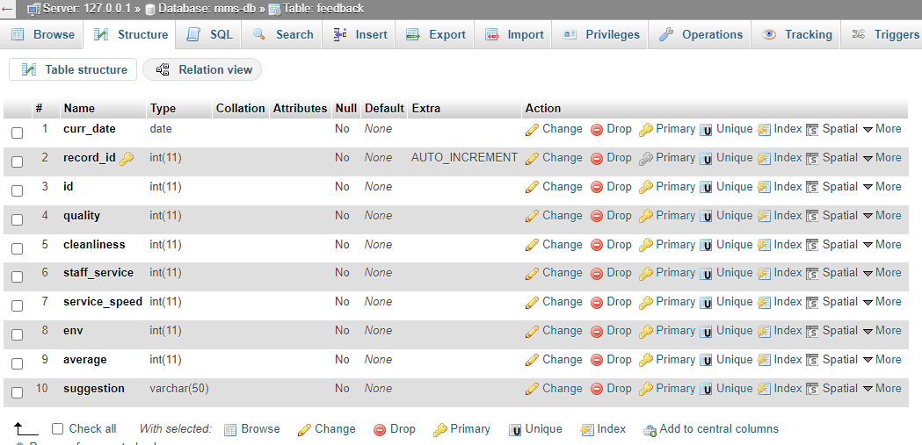
Feedback Database

Slide 46
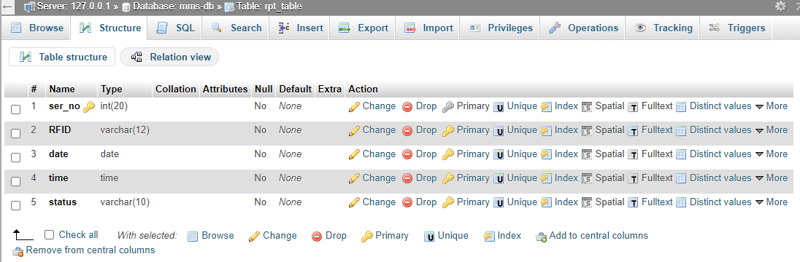
Report Table Database

Slide 47
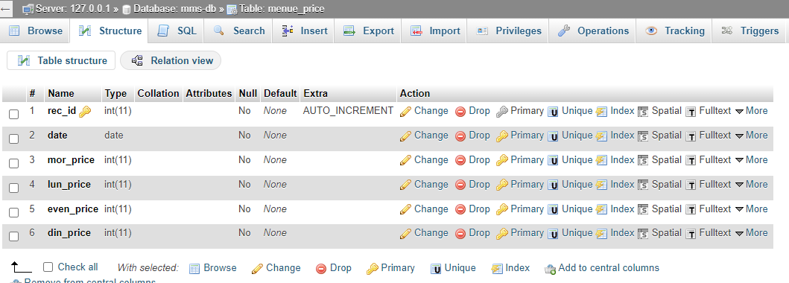
Menu Price Database

Slide 48
Conclusion: Result
This software will be useful to any school/college hostel or in general to any institute maintaining a mess or canteen. Security is maintained as the complete control of the system is only under the hands of an authorized person. It will enable mess managers to refer diet charts and plan healthy, nutritious diet accordingly for the cadets. Also, this system will enable Stock purchasing based on daily fluctuating rates. Since easy calculations and bill generations are done in minutes, therefore, it will lessen the work/load of mess managers. Using this software, alerts regarding the stock of commodities will be easily generated. It will never let scarcity prevail in the mess. Backup of data can be easily taken using this software on the click of a single button. Restoring the data back to the system is also possible in case of any failure. Also, this software will reduce manpower, thus reducing the capital being invested. This project can be merged with any major projects in future where meals and their monthly calculations need to be done.

Slide 49
Reference
Adam, J. and Kamuzora, F. (2008).Research Methods for Business and Social Studies. Mzumbe Book Project; Morogoro, Tanzania.
Ankita Chawla, Priyanka Joshi, Sanjana Panjwani, Surbhi Sontakke, ”Mess Management System”, International journal of science and engineering march-2015,vol:1 issue:2. Pg.: 82-85, e- ISSN: 2394-8299 p- ISSN: 2394-8280. [2] B Muniraja, J Rajanikanth, ”In-Time Billing Process for Canteen Management System” International Journal of Emerging Trends in Engineering Research (IJETER)
Swapna, M. Firdouse Ali Khan, “Design and Implementation of Ordering System for Restaurants”, in International Journal of Engineering Research & Technology (IJERT), Vol. 1, Issue 10, December- 2012 [6] S. B. Patil, Srikantha Rao, P. S. Patil 2001 „Canteen Management Design Principles‟ Proceedings of the International Conference & WorkShop on Trades in Technology, pp. 765-766, viewed 7 October 2001
Tan-Hsu Tan, Ching-Su Chang, Yung-Fu Chen, Yung-Fa Huang, Tsung-Yu Liu, “Developing an Intelligent e-Restaurant with a Menu Recommender for Customer-Centric Service”, Systems, Man, and Cybernetics, Part C: Applications and Reviews, IEEE Transactions.

Slide 50
Reference
Canteen Food Ordering Android System, Abhishek Singh, Amit Tanwar, Aditya Sawant, Chaitanya Parulekar, Kunal Yadav, IT Department, MUMBAI University, Journal on Recent and Innovation Trends in Computing and Communication, ISSN: 2321-8169.
Shweta Shashikant Tanpure, Priyanka R. Shidankar, Madhura M. Joshi, “Automated Food Ordering System with Real-Time Customer Feedback”, in International Journal of Advanced Research in Computer Science and Software Engineering, Vol.
Issue 2, February 2013. 3. S. B. Patil, Srikantha Rao, P. S. Patil 2001 ‘Canteen Management Design Principles’ Proceedings of the International Conference & Workshop on Trades in Technology, pp. 765-766, viewed 7 October 2001
Tomoko Kashima, Shimpei Matsumoto, and Hiroaki Ishii, “Recommendation Method with Rough Sets in Restaurant Point of Sales System”, PIMECS 2010 Vol III
AliAkhtarzada, Cristian S. Calude and John Hosking, “A MultiCriteria Metric Algorithm for Recommender Systems”, CDMTCS-400

Slide 51
Reference
Student Card System Using Smart Card Technology -Information Technology Based Higher Education and Training, 2004. ITHET 2004.Proceedings of the Fifth International Conference in January 2004 from the University of New South Wales UNSW, Sydney, NSW 2052, Australia.
S SumitaNainan1, Romin Parekh, Tanvi Shah - RFID Technology Based Attendance Management System from NMIMS University Mumbai, Maharashtra.
Anuj Pal Kapoor, Madhu Vij,” Technology at the dinner table: Ordering food online through mobile apps”, Journal of Retailing Customer Services 43 (2018), 342-351, 2018.
Jovin Kurichial, Shubham Shitole, Priyanka Kedar, "Automated Mess Service Based On Users Location", International Research Journal of Engineering and Technology (JET), Sept. 2017.
V. Swapna, M. Firdouse Ali Khan, “Design and Implementation of Ordering System for Restaurants”, International Journal of Engineering Research and Technology (IJERT), Vol. 1 Issue 10, December 2015.
[1] The ordering system – A.nayak and P.Ruthumbra. Journal of Engineering Science 2011 [2] Menu automation with vivid monitor- G.Vinod, S.Ramesh. NICE 2010 [3] Order Automation - M Jakhad, L.Rai , International Journal of Computer. May 2015. [4] OP. Naiyyar. A Kher , “A Proposed System for Android based Ordering system” IJSIET publications, issue 2, 2018 [5] RFID radio controlled order – JK Nada, KL. Vikram. B. Mane – IEEE paper, issue 4 volume 10. August 2017

Slide 52
Reference
http://www.organizationaldynamics.upenn.edu/system/files/Ac koff-1981-Mess-Management_0.pdf
http://www.gen.cam.ac.uk/department/library/libraryhandouts/ref-management-systems
http://spod.tarc.edu.my/SAS/fulltext/201112/AIA2/EngWeiSengAIA%20201112F.pdf
https://learn.shayhowe.com/html-css/building-your-first-web-page
https://www.djangoproject.com/
https://www.w3schools.com/sql/
www.google.com
www.wikipedia.co.in
www.tutorialspoint.com

Slide 53
THANK YOU

